Slide 1
Exam Result Management System
Group no-63

Slide 2
Our Team
Akbari Yagnikkumar Ashokbhai (20BECE30003)
Darji Dhruv Manishkumar (20BECE30025)
Gagiya Jaimin Hasmukhbhai (221SBECE30006)
Dave Meet Anil (221SBECE30005)

Slide 3
Internal Guide
Hitesh Barot

Slide 4
Problem statement
The exam result display method in college is manual and complex for faculty.
The exam department is declaring students’ results on the noticeboard, therefore some students create a crowded and noisy environment in the college.
Students can see any student marks and start comparing them with other students.

Slide 5
Our solution
We are building a web portal-based System to maintain student records, Exam records, student results, and result declarations this all tasks do in an online and automatic way.
Faculty just upload all Students and exam data in the system and students can see their details and result on the web portal.
Students can see their details, current result, and previous year’s results anytime anywhere.
Faculty can see all student details, current results and previous year results on this system anytime and anywhere.

Slide 6





Technology's used
Figma
Node JS
React
For user interface and experience design
Used for handling incoming requests
For designing complex components
Mongo DB
Express JS
It’s a non-relational document database
Minimal NodeJS framework

Slide 7
Users
01
02
03
Students
Faculty
Admin
Includes students of LDRP ITR
Includes faculty members of LDRP ITR
Includes an admin

Slide 8
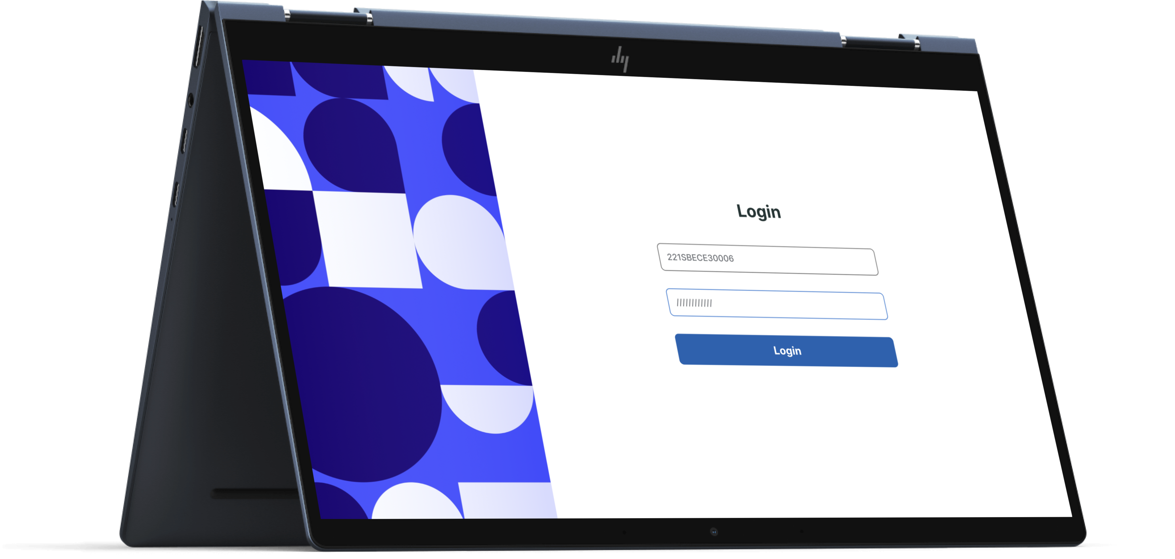
01
Students
Login
Reset Password

Slide 9
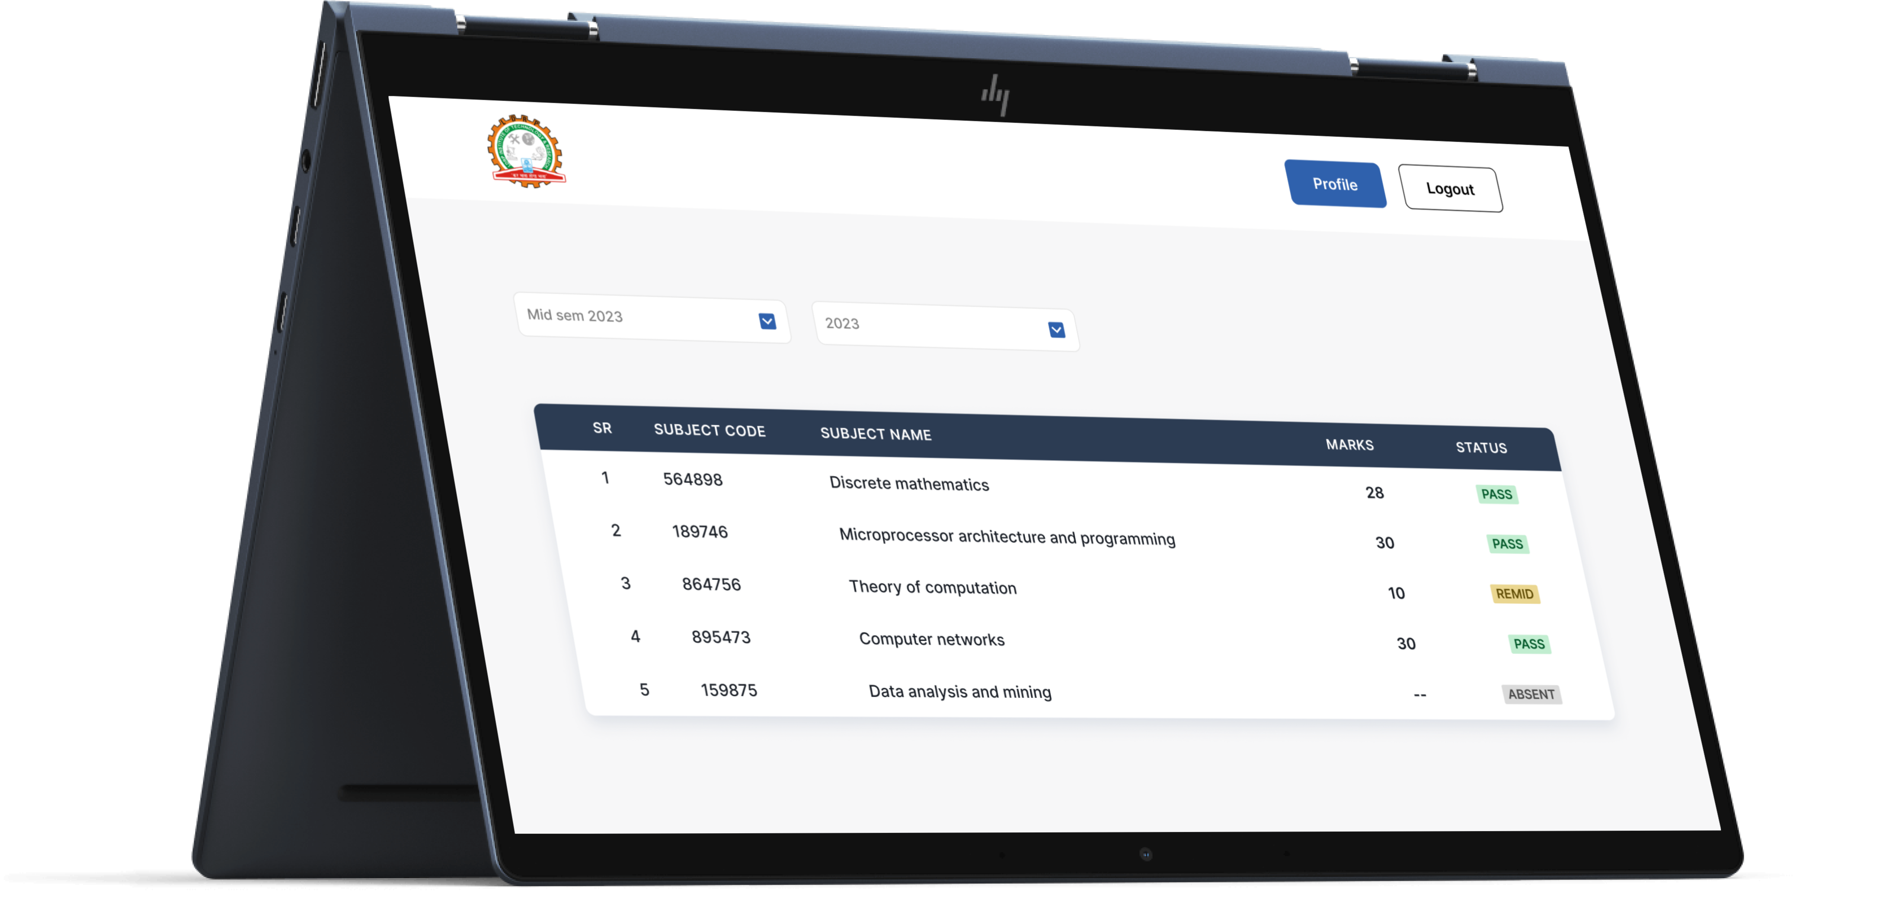
01
Students
View result
View profile

Slide 10
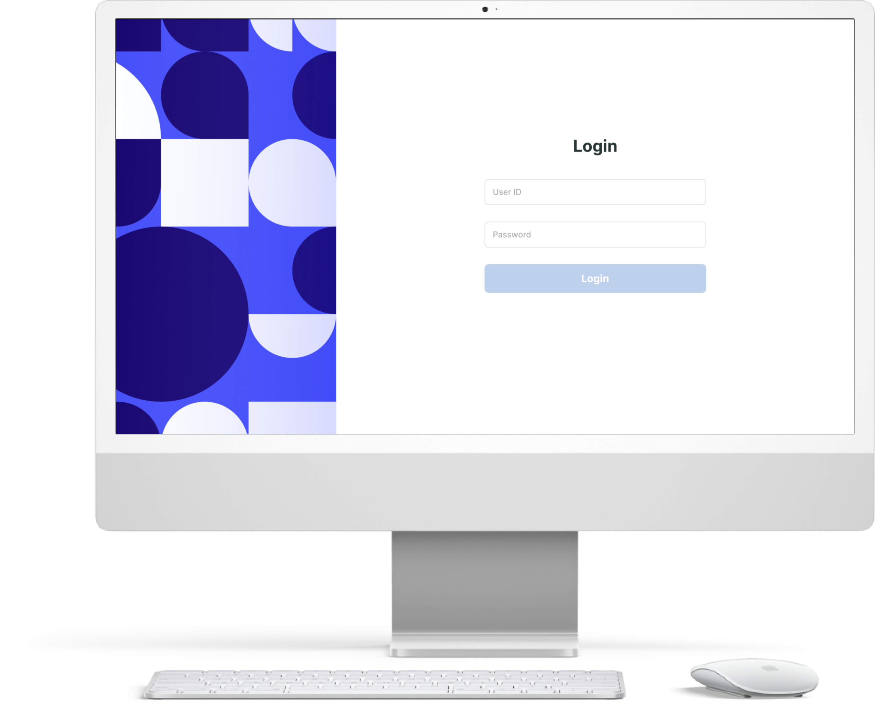
02
Faculty
Login
Reset change

Slide 11
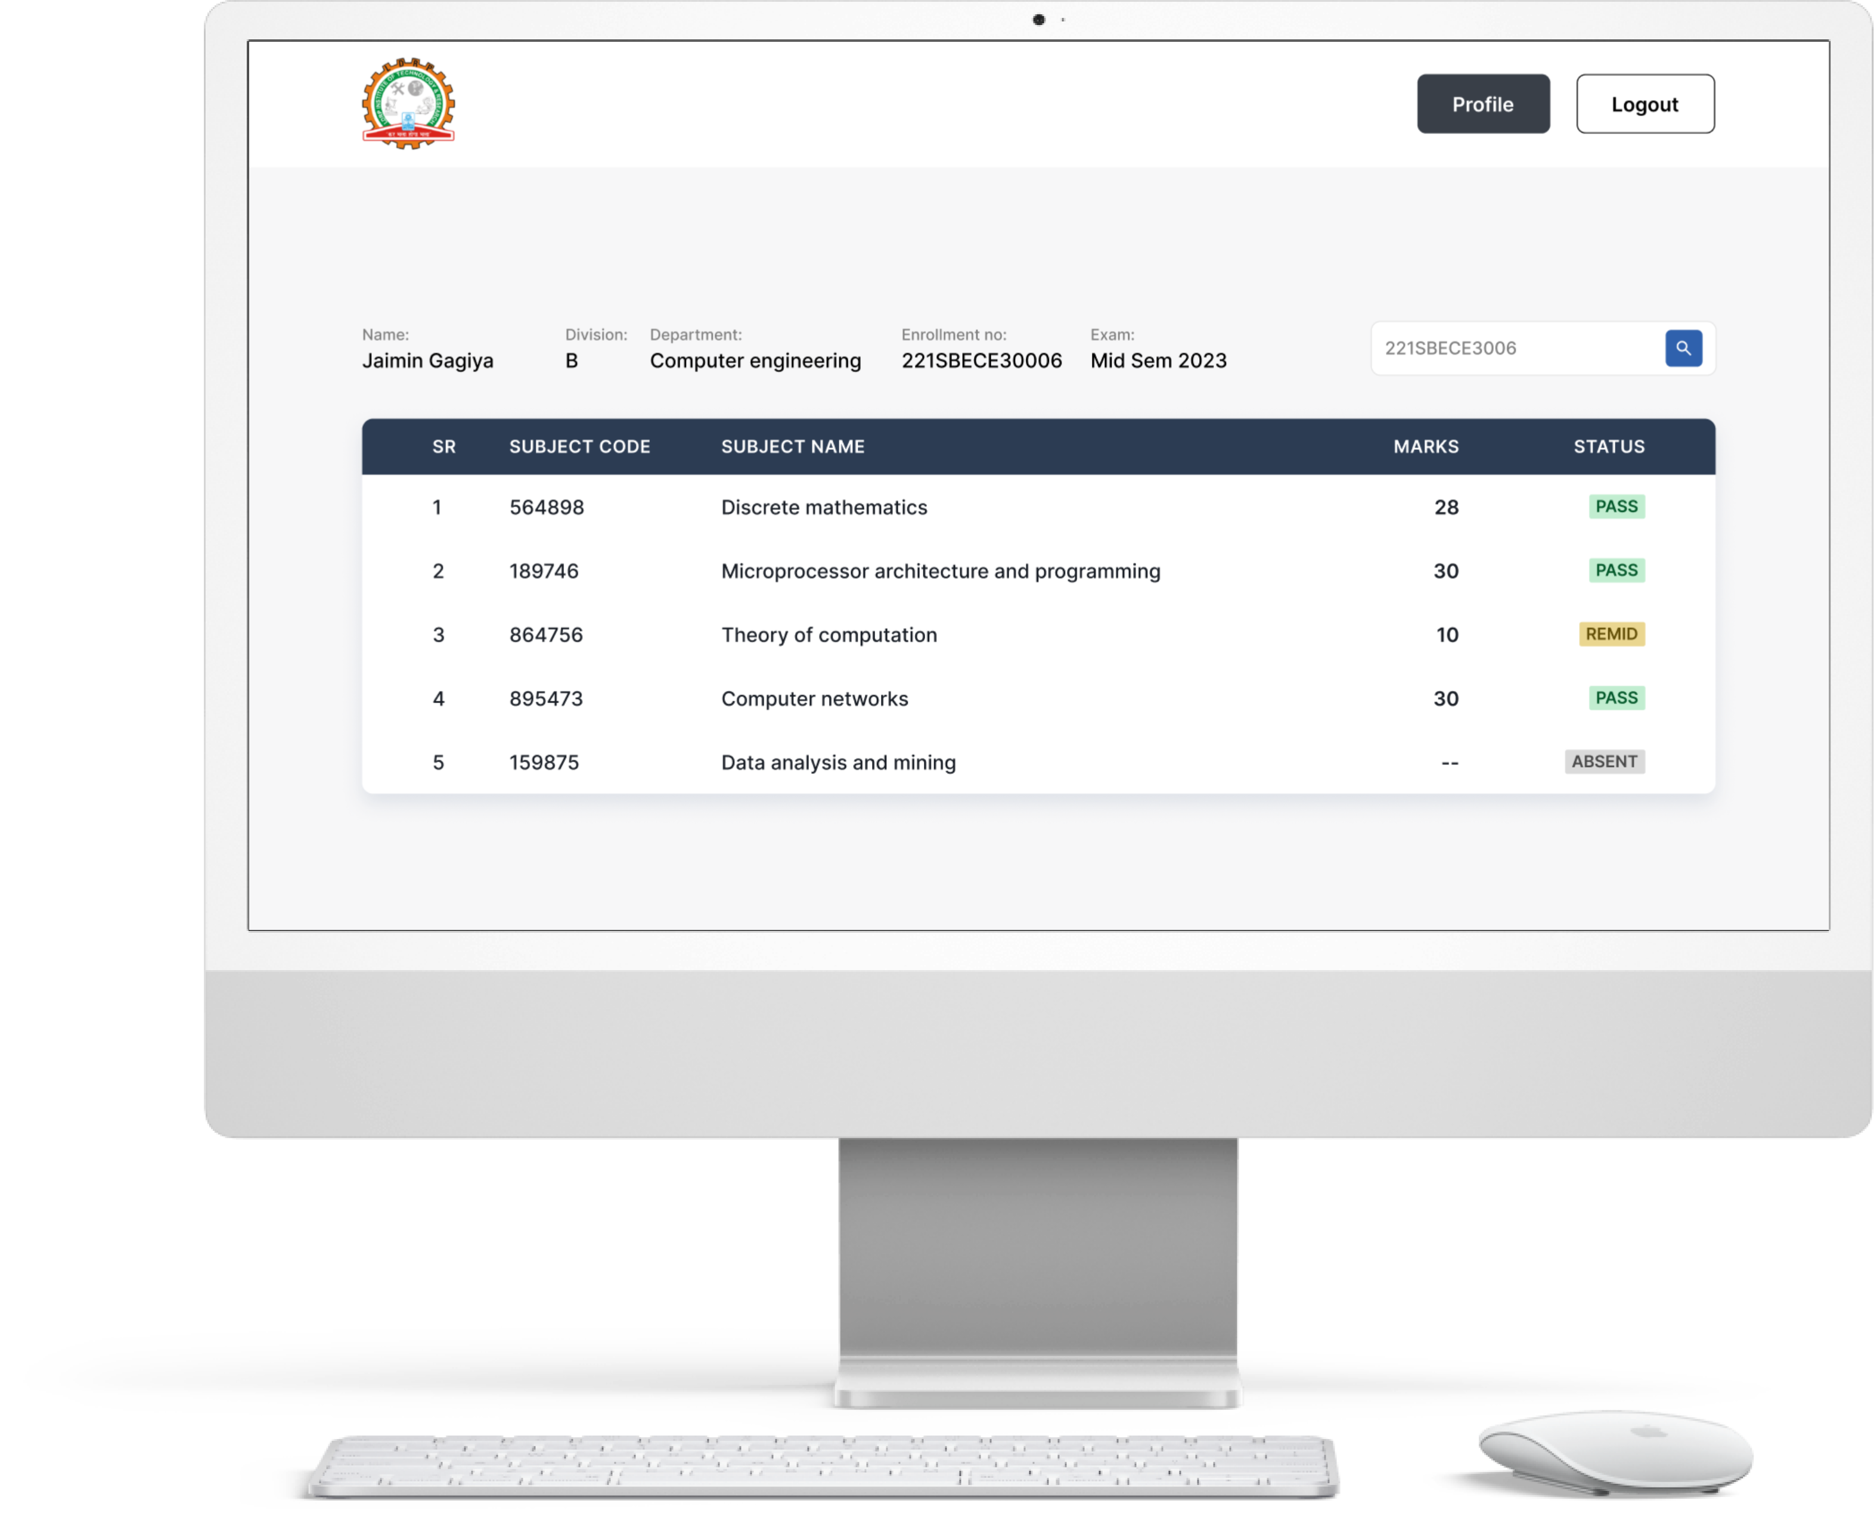
02
Faculty
View results of all students/individual

Slide 12

03
Admin
Login
Reset password
Upload result (Excel sheet)

Slide 13



Advantages of this system
Privacy
Efficiency
Time-saving

Slide 14
Future works
Faculty can view and print a list of failed students in the exam.
Faculty can view results division-wise.
Further improving the design by making it responsive.

Slide 15
Thank you

